Slide 1
Portfolio Presentation
School of Information Studies
Master of Science
Applied Data Science
Pankaj Yadav (429410363)
28 April 2024
https://github.com/pankajyadav01/ADS_Portfolio

Slide 2
Introduction
The Applied Data Science program at Syracuse University is designed to give students the skills necessary to become professionals who can analyze data to solve problems. It provides students the opportunity to collect, manage, analyze, and develop insights using data from a multitude of domains using various tools and techniques.
Reports and presentations were created in courses which exemplify the skills developed in the program including, but not limited to:
IST718: Big Data Analytics
IST736: Text Mining
IST 707: Applied Machine Learning
IST 691: Deep Learning
School of Information Studies

Slide 3
The Applied Data Science Program has seven Learning Objectives:
Describe a broad overview of the major practice areas in data science.
Collect and organize data.
Identify patterns in data via visualization, statistical analysis, and data mining.
Develop alternative strategies based on the data.
Develop a plan of action to implement the business decisions derived from the analyses.
Demonstrate communication skills regarding data and its analysis for relevant professionals in their organization.
Synthesize the ethical dimensions of data science practice
School of Information Studies

Slide 4
Yelp Recommendation System using PySpark
IST718: Big Data Analytics
The project goal for the Yelp recommendation system using PySpark is to create a sophisticated engine that enhances the platform’s value by:
Boosting user engagement through tailored content suggestions.
Elevating the overall user experience with efficient, personalized content discovery.
Fostering higher user retention with accurate and relevant recommendations.
Expanding the horizon of product discovery, leading users to new and interesting finds.
School of Information Studies

Slide 5
Yelp Recommendation System using PySpark
IST718: Big Data Analytics
Data Overview:
The Yelp reviews dataset is a collection of user reviews of businesses in Yelp.
The dataset contains over 8 million reviews and is labeled with the corresponding rating (1-5 stars) given by the reviewer.
The dataset also includes other information such as the text of the review, the business category, and the geographical location of the business.
We are currently using 3 different data files to obtain this dataset.
Businesses: 150346 records
Users: 1987896 records
Reviews: 6990280 records
School of Information Studies

Slide 6
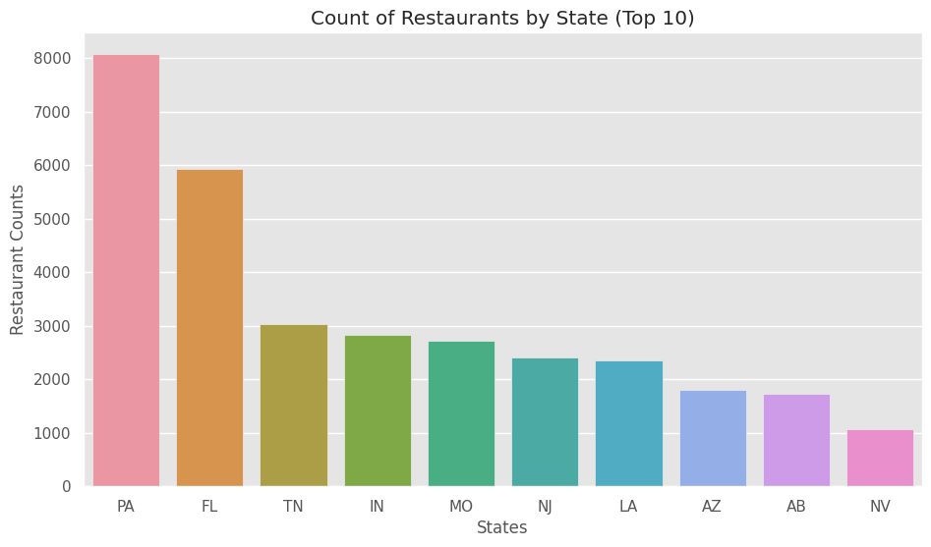
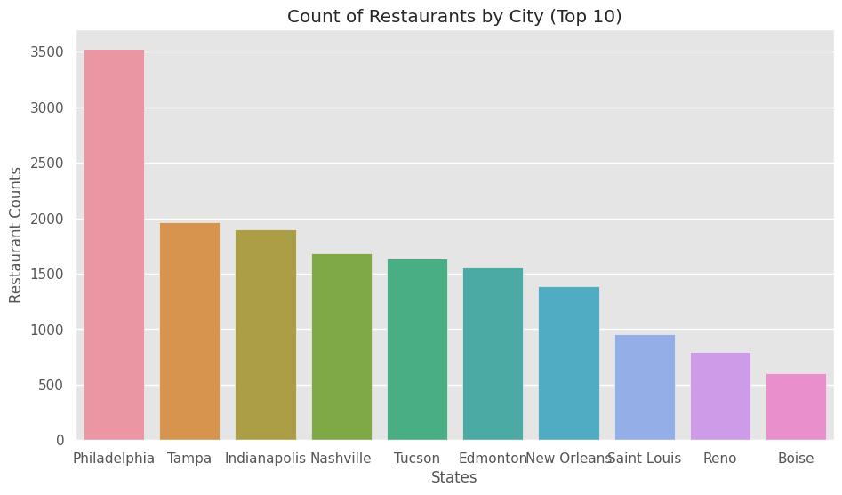
Yelp Recommendation System using PySpark
IST718: Big Data Analytics
Restaurant Distribution:
Based on the analysis, Pennsylvania state has the highest count of restaurants, and among the top 10 cities in the USA with the most restaurants, Philadelphia stands out significantly.
School of Information Studies

Slide 7
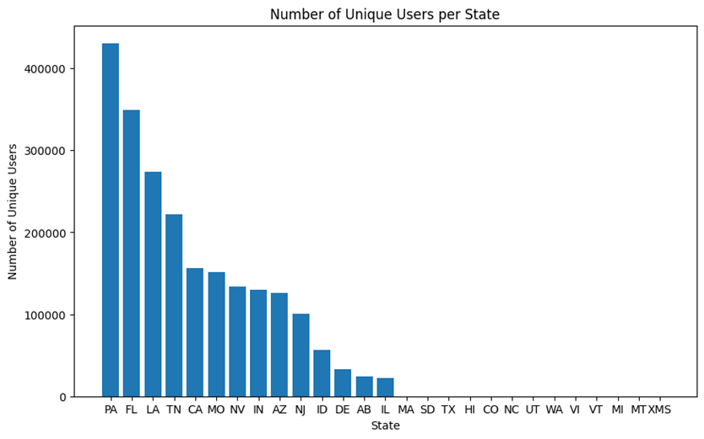
Yelp Recommendation System using PySpark
IST718: Big Data Analytics
Unique Users in Each State:
School of Information Studies

Slide 8
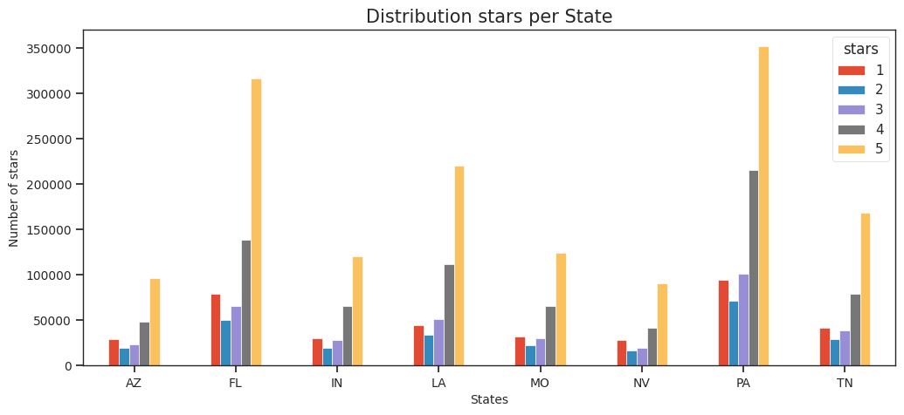
Yelp Recommendation System using PySpark
IST718: Big Data Analytics
Restaurants Stars Distribution by State:
According to the data, Pennsylvania (PA) received the largest number of 5-star ratings, with Florida (FL) coming in second place. These results are consistent with the proportion of restaurants per state that we observed earlier.
School of Information Studies

Slide 9
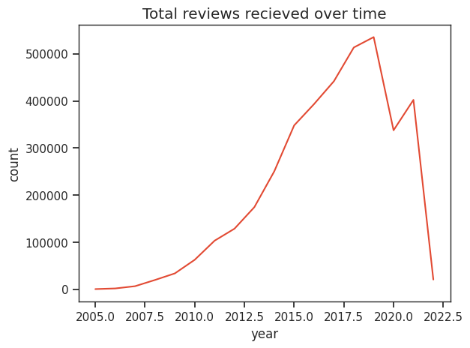
Yelp Recommendation System using PySpark
IST718: Big Data Analytics
Reviews Trend:
It appears that 2017 had the highest number of received reviews. Additionally, there was exponential growth in the number of reviews from 2010 to 2016. One possibility is that there was an increase in the use of online review platforms, which may have made it easier for people to leave reviews. This could have resulted in a higher volume of reviews overall, and particularly in 2017 when the platform may have reached peak popularity.
However, we can observe a steep decrease in the reviews as of 2019, this could be because of COVID-19 when people stater of avoid going out and started to social distance.
School of Information Studies

Slide 10
Yelp Recommendation System using PySpark
IST718: Big Data Analytics
Recommendation Engine:
We are using the k-means algorithm to cluster businesses together and then recommend users businesses based on the cluster they prefer.
We also clustered users based on the aggregate of categories of restaurants they have visited.
Within a cluster, the recommendations will be based on the location closest to each user. User location has been calculated based on mean of locations of the businesses visited by each user.
School of Information Studies

Slide 11
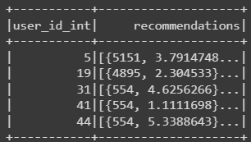
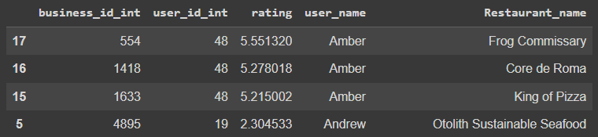
Yelp Recommendation System using PySpark
IST718: Big Data Analytics
Alternating Least Squares (ALS) Outcome:
Train Test Split: 70:30
Result RMSE: 1.301653214038206
School of Information Studies
Notes:
The ALS algorithm is a way to recommend things to people based on their past behavior. For example, it can be used to recommend movies to users based on their past movie ratings.
To do this, ALS represents users and movies as vectors in a special "hidden space" that's not directly observable. These vectors are called "latent factors". The ALS algorithm learns what these latent factors should be by looking at the past ratings that users have given to movies.
The key idea is that if two users have similar ratings for some movies, then their latent factor vectors in this hidden space should be similar as well. Similarly, if two movies have similar ratings from users, then their latent factor vectors should be similar too.
Once the algorithm has learned these latent factor vectors, it can predict how a user would rate a movie they haven't seen yet by taking the dot product of the user's latent factor vector and the movie's latent factor vector. The predicted rating is then used to recommend movies to the user.
To train the ALS algorithm, it tries to minimize the difference between the predicted ratings and the actual ratings in the training data. This is done by adjusting the latent factor vectors until the difference is as small as possible

Slide 12
SkillSpotter: Mining and Skills from Job Descriptions
IST736: Text Mining
The goal of this project is to train a model to identify relevant entities, which are: ​
Skills: such as “writing, critical thinking, persuasion” etc.​
Technology Skills: such as “python, R, SAP” etc.​
The purpose of this model would be to perform broad matching for example if the model was trained to identify “machine learning” it should also identify “machine-learning”, “ml”, “machine lerning”, “ML” etc.​
School of Information Studies

Slide 13
SkillSpotter: Mining and Skills from Job Descriptions
IST736: Text Mining
About the Data:
The dataset contains 187,853 web scraped job descriptions from various websites. ​
Each job description is uniquely identified by a 'Job ID’. ​
The core content of the dataset is the 'Job Description' column, which provides comprehensive details about each role. ​
A 'Skills' column which identifies few skills required in the job description itself. ,​
There’s also a web scraped list of 8,904 essential skills, both soft skills (35) and technical skills (8,869), identified from the reputable source onetonline.org. The combination of these columns presents a valuable resource for analyzing job market trends and skill demands.​
School of Information Studies

Slide 14







SkillSpotter: Mining and Skills from Job Descriptions
IST736: Text Mining
Data gathering
Web-scraped Job Description and master list for skills.
Methodology:
2. Data Cleaning
Cleaning the data by removing html tags, null values.
3. Data Sampling
Sampling only the relevant data form manually selected list of 34 job titles.
4. Data Transformation
Tokenization, BIO Tagging, flattening the data before using Data Collator to create tensors for model training.
5. Model Training & Evaluation
Used a Distilbert-base-uncased model with an 80-20 split for model training and got over 98% accuracy.
6. Model Inference
Inferenced our model over sample sentences to test and evaluate the model.
7. Final Use Case (Skills)
Model can be used to find similarity scores between resume and job description and thus be used as a recommendation model.
4
School of Information Studies

Slide 15
SkillSpotter: Mining and Skills from Job Descriptions
IST736: Text Mining
Data Cleaning: ​
Out of ~87000 unique job titles we focused on a few tech roles that had overall more than 30 postings.​
We manually filtered 34 job titles which were relevant to our scope.​
Parsed skills as list.​
Software Engineer​ | Senior Software Engineer​ | Software Development Engineer​ | Research Associate​ | Financial Analyst​
Product Manager​ | Business Analyst​ | Business Development Representative​ | Principal Software Engineer​ | Data Engineer​
Data Scientist​ | Mechanical Engineer​ | Data Analyst​ | Software Development Manager​ | Senior Data Engineer​
Systems Engineer​ | Associate Scientist​ | Senior Product Manager​ | Research Scientist​ | Research Associate I​
DevOps Engineer​ | Scientist​ | Java Developer​ | Software Engineer II​ | Project Engineer​
Business Systems Analyst​ | Program Director​ | UX Designer​ | Senior Program Manager​ | Senior Software Development Engineer​
Engineer​ | Software Developer​ | Senior Business Analyst​ | Senior Data Scientist​ | ​
School of Information Studies

Slide 16
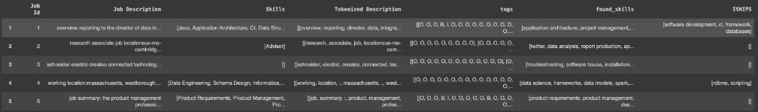
SkillSpotter: Mining and Skills from Job Descriptions
IST736: Text Mining
Tokenization and BIO Tagging:
Performed sentence level tokenization followed by word tokenization,​
Performed pattern matching to create BIO tags.​
Extracted skills using BIO tags.​
Compared Extracted skills with skills mentioned explicitly in data.​
School of Information Studies

Slide 17
SkillSpotter: Mining and Skills from Job Descriptions
IST736: Text Mining
Data Parsing:
Flattened the job descriptions to create training data for token level classification.​
Removed all sentences where no skills were mentioned. ​
Final dataset consisted of about 18000 BIO tagged sentences.​
Job Id​ | Sentence​ | Tags​
1​ | [overview, reporting, director, data, integrat...​ | [O, O, O, B, I, O, O, O, O, O, O, O, O, O, O, ...​
1​ | [individual, expected, key, contributor, ideat...​ | [O, O, O, O, O, O, O, O, O, O, O, B, I, O, O, ...​
1​ | [position, play, important, role, producing, d...​ | [O, O, O, O, O, B, O, O, O, O, O, O, O, O, O, ...​
1​ | [opportunity, part, innovative, engineering, t...​ | [O, O, O, O, O, O, O, O, O, O, O, O, O, O, O, ...​
1​ | [responsibilities, designs, ,, codes, ,, verif...​ | [O, O, O, O, O, O, O, O, O, O, O, O, O, O, O, ...​
School of Information Studies

Slide 18
SkillSpotter: Mining and Skills from Job Descriptions
IST736: Text Mining
We used a distilbert_base_uncased tokenizer to perform sub-word tokenization on our sentences. This led to misalignment in our sentence tokens and BIO tags.​
Truncated and padded all sentences to 512 words.​
We created a custom function to align tags with the subword tokens.​
[CLS]​ | overview​ | reporting​ | director​ | data​ | integration​ | services​ | ,​ | er​ | ##t​ | looking​ | full​ | stack​
-100​ | 0​ | 0​ | 0​ | 1​ | 2​ | 0​ | 0​ | 0​ | 0​ | 0​ | 0​ | 0​
developer​ | work​ | key​ | stakeholders​ | applying​ | technical​ | proficiency​ | across​ | different​ | stages​ | software​ | development​ | life​
0​ | 0​ | 0​ | 0​ | 0​ | 0​ | 0​ | 0​ | 0​ | 1​ | 2​ | 2​ | 2​
cycle​ | including​ | requirements​ | gathering​ | ,​ | application​ | architecture​ | design​ | .​ | [SEP]​ | [PAD]​ | [PAD]​ | [PAD]​
0​ | 0​ | 0​ | 0​ | 1​ | 2​ | 0​ | 0​ | 0​ | -100​ | -100​ | -100​ | -100​
School of Information Studies

Slide 19
SkillSpotter: Mining and Skills from Job Descriptions
IST736: Text Mining
Data Training:
Transformed the data to train disbert-base-uncased model. Final data consisted of input ids, attention masks and labels where labels are the numeric BIO tags.​
80-20 Train-Test split. ​
Used a data collator for tensor conversion and batching ensuring that the data is correctly formatted for the model.​
School of Information Studies

Slide 20
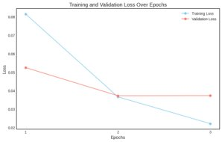
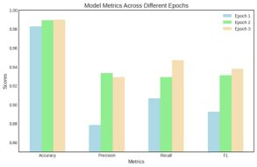
SkillSpotter: Mining and Skills from Job Descriptions
IST736: Text Mining
Results:
We trained for 3 epochs with a constant learning rate of 0.00005​
Training ran for 40 minutes​
We can see the model is performing quite well.​
Epoch​ | Training Loss​ | Validation Loss​ | Precision​ | Recall​ | F1​ | Accuracy​
1​ | 0.081500​ | 0.052436​ | 0.878380​ | 0.906783​ | 0.892356​ | 0.982703​
2​ | 0.036600​ | 0.037228​ | 0.933150​ | 0.929218​ | 0.931180​ | 0.989165​
3​ | 0.022100​ | 0.037300​ | 0.929096​ | 0.946809​ | 0.937868​ | 0.989842​
School of Information Studies

Slide 21
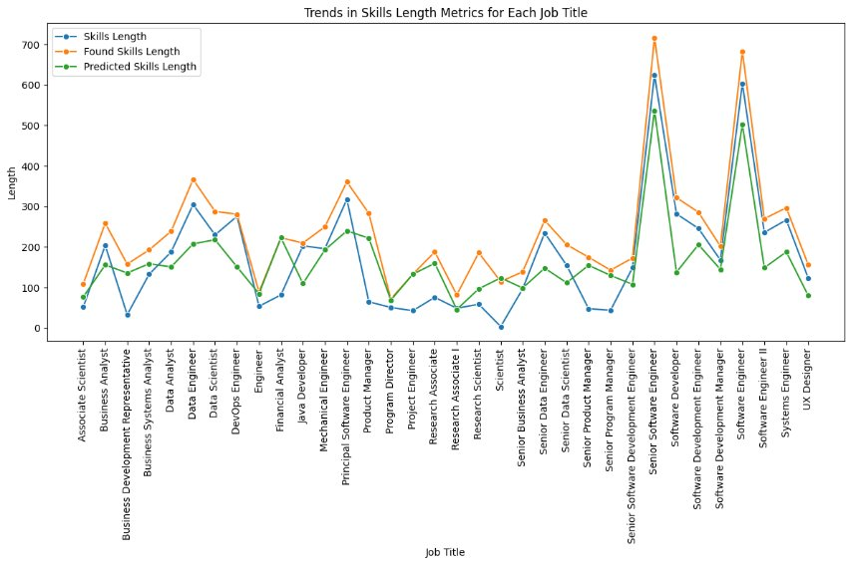
SkillSpotter: Mining and Skills from Job Descriptions
IST736: Text Mining
Insights:
Found skills vs Skills​: We can in general that we have found more skills than there were given explicitly in the job description through pattern matching to our master list.​
Found skills vs Predicted skills​​: In many of the categories there were less skills predicted than we found with pattern matching​.​ This may be due to untuned parameters or misannotated words.
Predicted skills vs Skills​: We can see predicted skills are more than the explicitly mentioned skills in most categories​.​ This means that our model is performing well, and we were able to extract more information about skills than mentioned explicitly in the job description.​
School of Information Studies

Slide 22
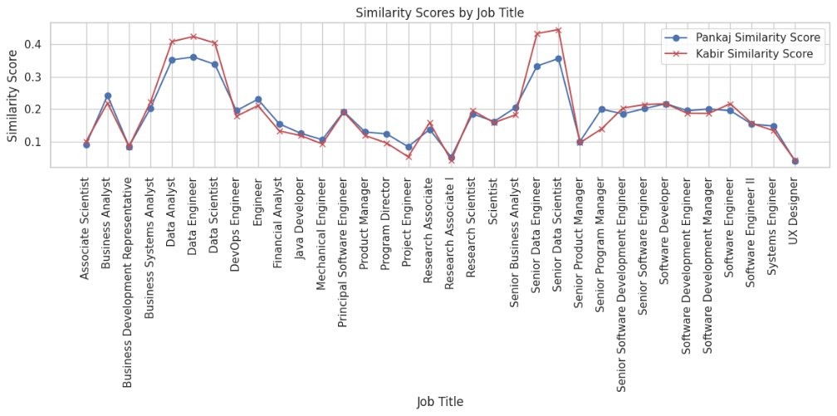
SkillSpotter: Mining and Skills from Job Descriptions
IST736: Text Mining
Use Case:
School of Information Studies

Slide 23
SkillSpotter: Mining and Skills from Job Descriptions
IST736: Text Mining
Conclusion:
In conclusion the model performed well, but not as accurately as pattern matching. ​
The best technique would be to use a combination of both methods, pattern matching to find known skills and a model to keep the pattern matching list updated.​
This model can be used to create a recommendation engine for Jobs or even to check how similar your resume is to the job description. ​
School of Information Studies

Slide 24
Sign-Vision: An Image Classification System for ASL
IST707: Applied Machine Learning
The primary objective was to develop a deep learning-based image classification model specifically designed to detect sign language.
The main goal was to develop image classification models that could accurately detect and identify different signs used in sign language.
Utilizing advanced machine learning and deep learning techniques, the project achieved a high level of accuracy and precision in sign recognition. This initiative significantly enhanced accessibility for individuals with hearing impairments and served as a powerful communication tool in various settings.
School of Information Studies

Slide 25
Sign-Vision: An Image Classification System for ASL
IST707: Applied Machine Learning
About The Data:
Data from: Kaggle dataset​
It is an Image Dataset. Each label represents an image.​​
There 142k images files with 36 labelled classes for ASL dataset.​
The data includes different sign language gestures with different background images, lightings, brightness, image conditions etc.​​
Apart from the Standard 36 sign characters (26 alphabets + 10 digits), we added some additional signs as bell such as delete, space etc, with 1000 images each.
School of Information Studies

Slide 26
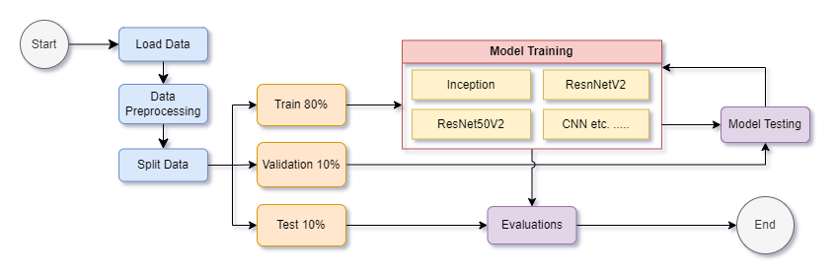
Sign-Vision: An Image Classification System for ASL
IST707: Applied Machine Learning
Methodology:
We trained multiple models using various architectures. To ensure optimal performance, we trained these models through multiple iterations and evaluated them on the validation dataset. This allowed us to fine-tune their hyperparameters and adjust their architectures to improve accuracy. Finally, once we obtained acceptable results on the validation dataset, we tested our models on the testing set for final evaluation. Based on these results, we selected the best-performing model for deployment.
To obtain the best-performing model, we performed this procedures on various CNN architectures ranging from small VGG architectures to large Resnet50 architectures. We also performed the same on Standard ML models like Random Forests and SVM for comparison.
School of Information Studies

Slide 27
Sign-Vision: An Image Classification System for ASL
IST707: Applied Machine Learning
Models Trained and their outcomes:
Classification Models | Accuracy
InceptionResNetv2 with ImageNet | 92.41%
ResNetV2 | 99.35%
ResNet50V2 | 96%
CNN ( 1 layer) | 98.26%
CNN (3 layers) | 98.57%
Decision Tree | 96.78%
Naive Bayes | 42%
Multilevel Perceptron | 98%
IsSign Models | Accuracy
Multilevel Perceptron | 100%
Decision Tree | 100%
School of Information Studies

Slide 28
Sign-Vision: An Image Classification System for ASL
IST707: Applied Machine Learning
Conclusion:
After building and testing multiple image classification models, we found that the ResNet50V2 model worked best when classifying sign language images.
The Multilayer Perceptron model performed better for binary classification of sign language images versus non-sign language images.
Our system showed promising results and can be used in a variety of applications, such as developing sign language translation tools, enhancing accessibility in public spaces, and aiding in sign language education. The use of multiple models and binary classification has proven to be an effective approach for improving the accuracy and precision of our system.
School of Information Studies

Slide 29

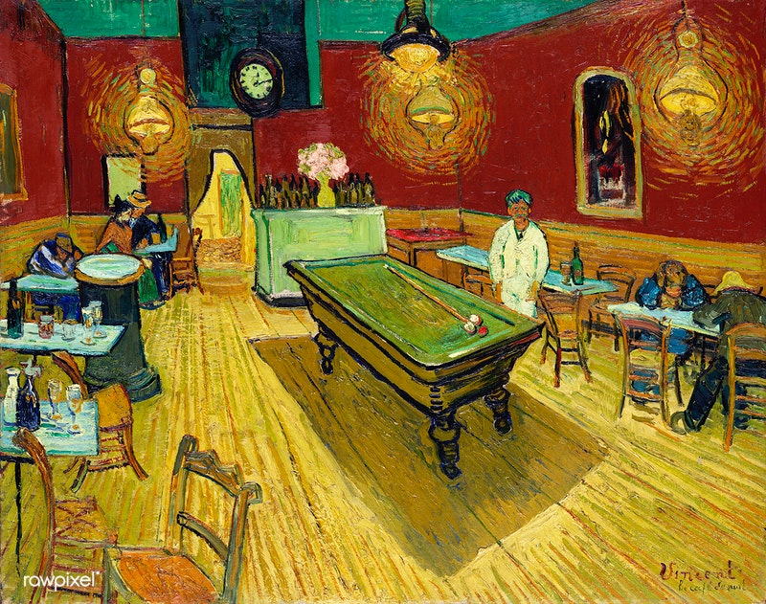
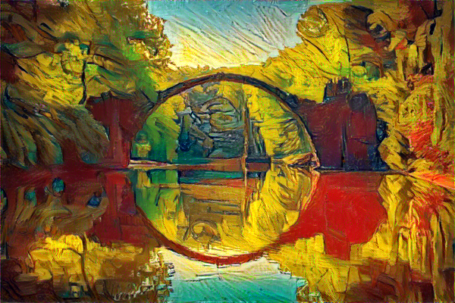
Neural Artistry: A Journey through Style Transfer
IST 691: Deep Learning in Practice
Project Overview:
Neural Style Transfer is the technique to leverage deep neural networks to analyze and blend a content image and a style image​
Content Image – Subject image​
Style Image – Image contributing artistic style ​
Objective – Create a script to run NST experiments and study factors that drive style transfer​
Applications - Snapchat/Instagram filters, apps like Prisma​
School of Information Studies

Slide 30
Neural Artistry: A Journey through Style Transfer
IST 691: Deep Learning in Practice
Methodology:
Define class
We created a modular class to run all NST experiments. Set initial default parameters
2. Create functions
Wrote setter and getter functions to manipulate class parameters.
3. Run Experiments
Run experiments by varying the parameters of NST.
4. Observe Style transfer
Observed the loss minimization graphically visually using plots and gifs.
5. Update class
Updated the class on final tuned NST parameters as default parameters.
School of Information Studies

Slide 31
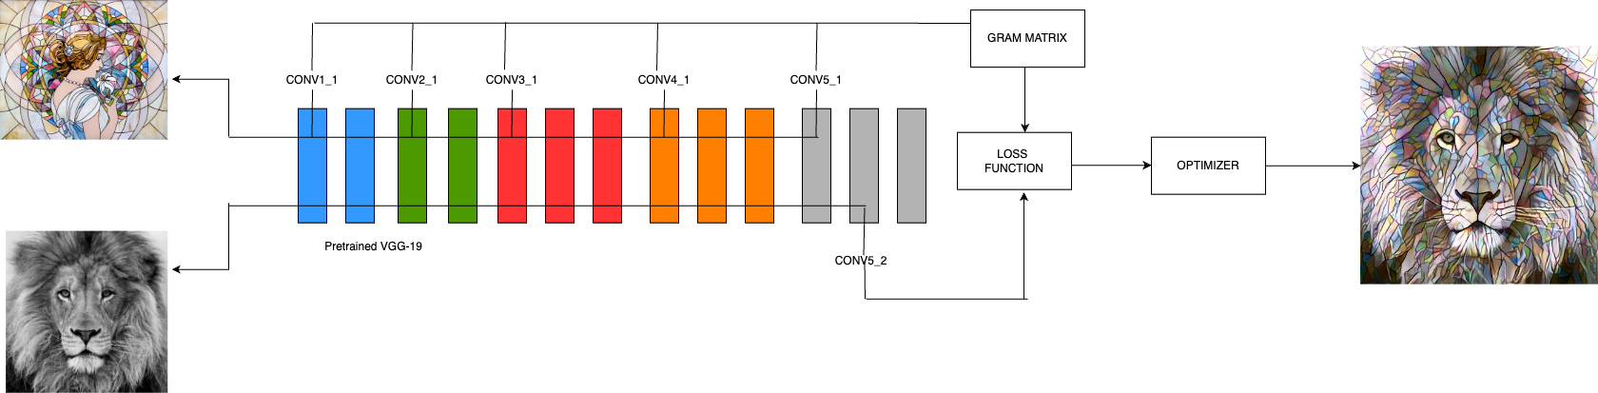
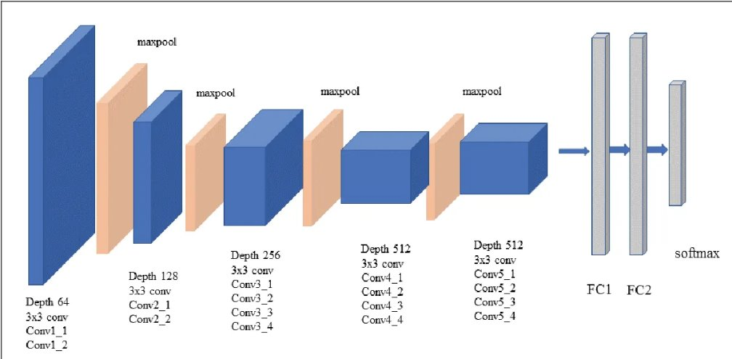
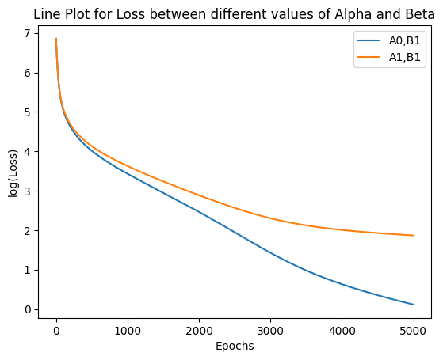
Neural Artistry: A Journey through Style Transfer
IST 691: Deep Learning in Practice
Methodology:
Style Image
Content Image
Iteratively minimize the loss until the style and content converge to generate the target image
$$L=αL_{content}\left(x\right)+β∑ L_{style}( G\left(x\right))$$
School of Information Studies

Slide 32
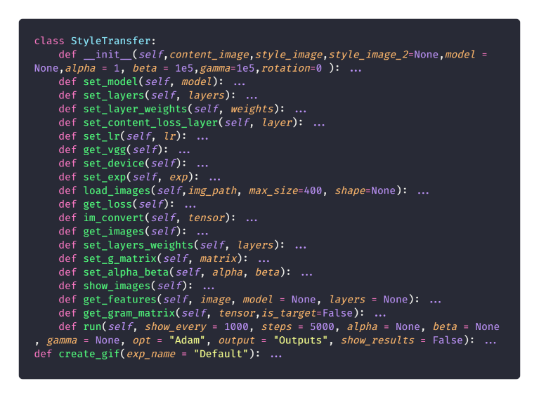
Neural Artistry: A Journey through Style Transfer
IST 691: Deep Learning in Practice
Experiments:
Experiment 0: Checking loss variation among Adam and L-BFGS Optimizers​
Experiment 1: Content & Style loss weight manipulation with L-BFGS Optimizer​
Experiment 2: Content & Style loss weight manipulation with Adam Optimizer ​
Experiment 3: Checking effects of selected layers on the generated image on VGG19 and AlexNet​
Experiment 4: Feature Matrix rotation effects on the generated image​
Experiment 5: Using two style images instead of one​
School of Information Studies

Slide 33
Neural Artistry: A Journey through Style Transfer
IST 691: Deep Learning in Practice
Experiments Results and Insights:
Experiment 0
Comparing Adam and L-BFGS optimizers over the same parameters we found that Adam performed much better than L-BFGS on our initial default parameters. Looking at the convergence of the losses we found that LBFGS had a huge initial spike thus the parameters warranted tuning.
Experiment 1 and 2
Experiment 1 tells us that the best values for alpha and beta for L-BFGS are in the range 0<𝛼<1 and 0<𝛽<1𝑒2 and for the Adam optimizer are 𝛼≤𝛽
We also observed that low values of 𝛼 and 𝛽 are preferred, because excessively large values of 𝛼 and 𝛽 don’t give us significantly better results and only increases the processing time and increases the loss range.
For low 𝛼 and 𝛽, L-BFGS and Adam both show similar loss convergence trends, however, due to slower convergence and unpredictability of L-BFGS for high low 𝛼 and 𝛽, we prefer to use Adam Optimizer.
School of Information Studies

Slide 34
Neural Artistry: A Journey through Style Transfer
IST 691: Deep Learning in Practice
Experiments Results and Insights (Cont.):
Experiment 3
VGG19 can extract more style from the style image but is slower than AlexNet. Using the middle convolution layers in both models was the most effective way of extracting the style elements from style image.
Experiment 4
The images rotated by 0º and 180º are similar and the images rotated by 90º and 270º are similar. However, the rotated images are simply distorted and there is not much difference in style between them.
Experiment 5
Using two different style images we can merge the styles of two images into one content image with good visual evidence.
School of Information Studies

Slide 35


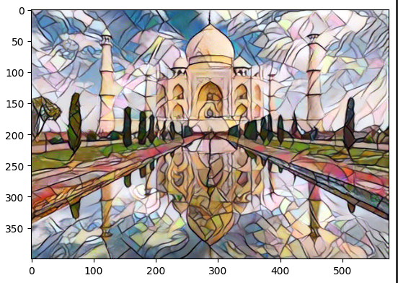
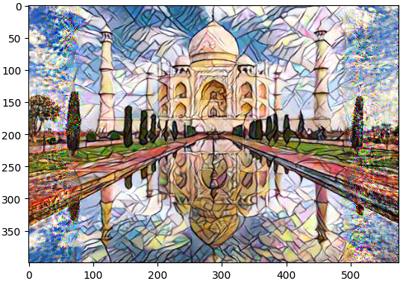
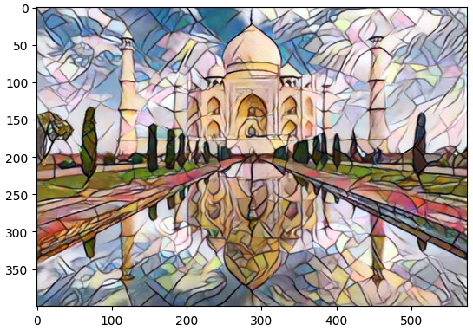
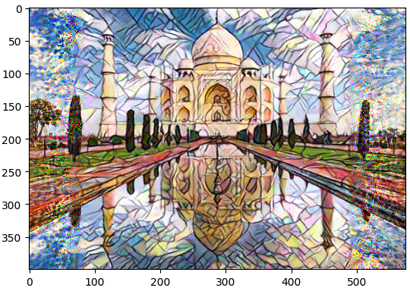
Neural Artistry: A Journey through Style Transfer
IST 691: Deep Learning in Practice
Result Images (Exp 4):
Style Image
Content Image
Rotation=0º
Rotation=90˚
Rotation=180˚
Rotation=270˚
School of Information Studies

Slide 36
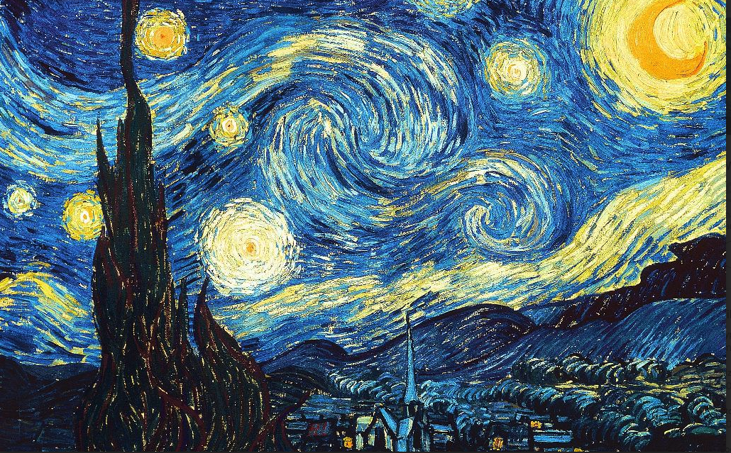
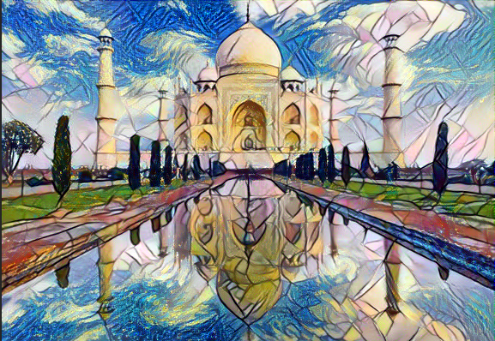
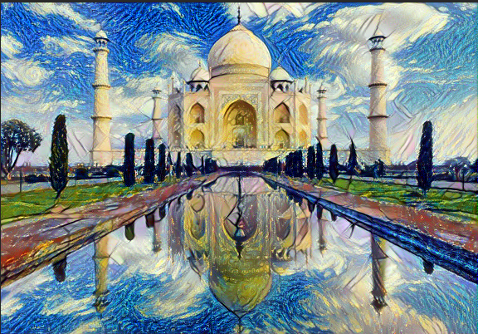
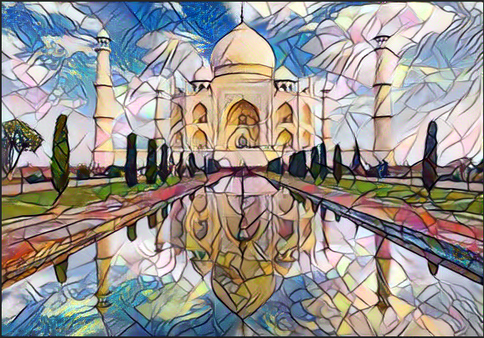
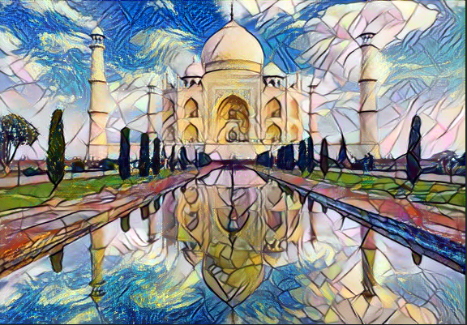
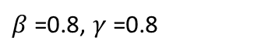
Neural Artistry: A Journey through Style Transfer
IST 691: Deep Learning in Practice
Result Images (Exp 5):
Style Image 1 (beta)
Style Image 2 (gamma)
Content Image (alpha = 0.2)
$β$=0.8, $γ$=0.8
beta=0.2,gamma=1
beta=1,gamma=0.2
beta=0.8,gamma=0.6
School of Information Studies

Slide 37
Neural Artistry: A Journey through Style Transfer
IST 691: Deep Learning in Practice
Conclusion:
In our final class for Neural Style Transfer, we suggest using the following hyper parameters for the best results.
VGG19 Model
Adam Optimizer for lower number of epochs and L-BFGS otherwise.
Content Layer – Conv5_2
Style Layers – Conv2_1, Conv3_1, Conv4_1
Loss Weights 𝛼=0.2 and 𝛽=0.8
School of Information Studies

Slide 38
Learning Objectives
This portfolio has demonstrated successful implementation of the program’s learning objectives and the major practice areas of data science. Each application involved an increasing level of complexity, and characterized the progression of these skills.
The projects displays the utilization for skills at different levels of complexity ranging from basic data visualization and EDAs to highly complex usage of prebuilt language models and advanced understanding of Deep Learning Concepts.
Communications skills were displayed in the organization and delivery of insights, expressing them in terms which could be simply understood and acted upon.
These projects are representative of the successful execution of the learning objectives and have developed the necessary skills for practice in the field of data science.
School of Information Studies

Slide 39
Conclusion
The School of Information Studies at Syracuse University equips its students with the tools necessary for the assimilation and governance of data, alongside the expertise to transform this data into strategic insights through a variety of data science methodologies.
The competencies acquired throughout this curriculum have honed a versatile problem-solving skill set applicable to both organized and more chaotic data scenarios of growing intricacy.
Students are trained to devise methods that elevate an organization's operational effectiveness.
The curriculum emphasizes the importance of clarity, replicability, and principled data stewardship, which enhances the reliability of a company's analytics division.
Graduates from the Applied Data Science course are well-prepared to address a broad spectrum of issues, bringing to the table the proficiency to communicate their findings to diverse groups, including industry experts and decision-makers.
School of Information Studies

Slide 40
Github Links and References
Portfolio: https://github.com/pankajyadav01/ADS_Portfolio
Yelp Recommendation System using PySpark: https://github.com/pankajyadav01/ADS_Portfolio/tree/main/Yelp%20Recommendation%20System
SkillSpotter: Mining and Skills from Job Descriptions using NER: https://github.com/pankajyadav01/ADS_Portfolio/tree/main/SkillSpotter
Sign-Vision: An Image Classification System For Sign Language Detection: https://github.com/pankajyadav01/ADS_Portfolio/tree/main/SignVision
Neural Artistry: A Journey through Style Transfer: https://github.com/pankajyadav01/ADS_Portfolio/tree/main/Neural%20Artistory
School of Information Studies

Slide 41
Thank You!
School of Information Studies

